Slide 1
2. Stack and Queue
Part 1: Stack

Slide 2
Stack
Objectives
Stacks
Array-based stack
Stack implemented by a singly linked list
Stack class in java.util

Slide 3
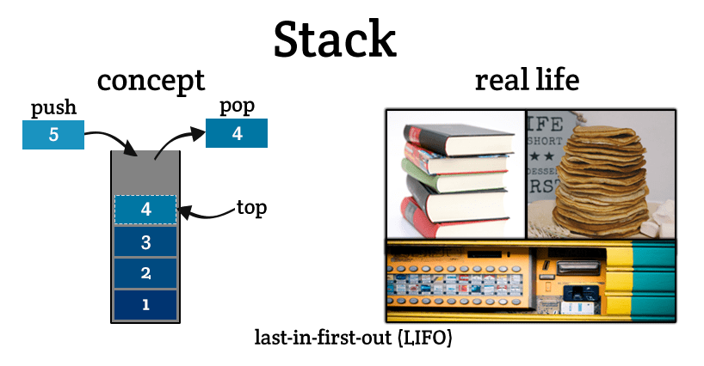
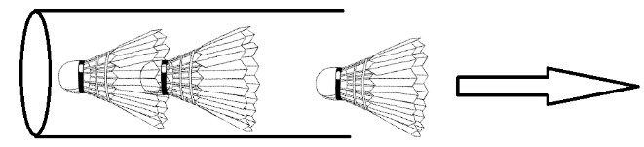
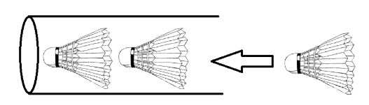
What is a stack?

Slide 4
What is a stack?
A stack is a linear data structure that can be accessed only at one of its ends for storing and retrieving data
A stack is a Last In, First Out (LIFO) data structure
Anything added to the stack goes on the “top” of the stack
Anything removed from the stack is taken from the “top” of the stack
Things are removed in the reverse order from that in which they were inserted

Slide 5
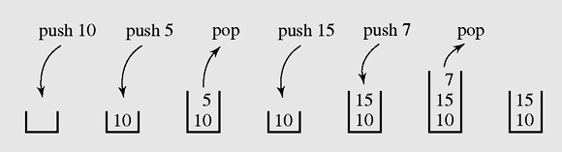
Operations on a stack
The following operations are needed to properly manage a stack:
clear() — Clear the stack
isEmpty() — Check to see if the stack is empty
push(el) — Put the element el on the top of the stack
pop() — Take the topmost element from the stack
top() — Return the topmost element in the stack without removing it
Operations on a stack

Slide 6
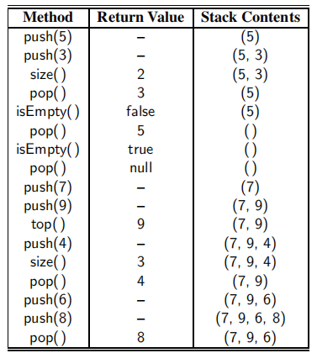
a series of stack operation

Slide 7
Applications of Stacks
Stacks are used for:
Any sort of nesting (such as parentheses)
Evaluating arithmetic expressions (and other sorts of expression)
Implementing function or method calls
Keeping track of previous choices (as in backtracking)
Keeping track of choices yet to be made (as in creating a maze)
Undo sequence in a text editor.
Auxiliary data structure for algorithms
Component of other data structures

Slide 8
Applications of Stacks
Stacks are used for:
Any sort of nesting (such as parentheses)
Evaluating arithmetic expressions (and other sorts of expression)
Implementing function or method calls
Keeping track of previous choices (as in backtracking)
Keeping track of choices yet to be made (as in creating a maze)
Undo sequence in a text editor.
Auxiliary data structure for algorithms
Component of other data structures

Slide 9
Stack in computer memory
How does a stack in memory actually work?
Each time a method is called, an activation record (AR) is allocated for it. This record usually contains the following information:
Parameters and local variables used in the called method.
A dynamic link, which is a pointer to the caller's activation record.
Return address to resume control by the caller, the address of the caller’s instruction immediately following the call.
Return value for a method not declared as void. Because the size of the activation record may vary from one call to another, the returned value is placed right above the activation record of the caller.
Each new activation record is placed on the top of the run-time stack
When a method terminates, its activation record is removed from the top of the run-time stack
Thus, the first AR placed onto the stack is the last one removed
AR is also called Stack frame

Slide 10
Array-based Stack - 1
A simple way of implementing the Stack ADT (abstract data type) uses an array
We add elements from left to right
A variable top keeps track of the index of the top element
…
S
0
1
2
top
Array-based stack

Slide 11
Array-based Stack - 2
The array storing the stack elements may become full
A push operation will then throw a FullStackException
Limitation of the array-based implementation
Not intrinsic to the Stack ADT
…
S
0
1
2
top
Array-based stack may become full

Slide 12
Array implementation of a stack
class ArrayStack
{protected Object [] a; int top, max;
public ArrayStack()
{ this(50);
}
public ArrayStack(int max1)
{ max = max1;
a = new Object[max];
top = -1;
}
protected boolean grow()
{ int max1 = max + max/2;
Object [] a1 = new Object[max1];
if(a1 == null) return(false);
for(int i =0; i<=top; i++) a1[i] = a[i];
a = a1;
return(true);
}
public boolean isEmpty()
{ return(top==-1);}
public boolean isEmpty()
{ return(top==-1);}
public boolean isFull()
{ return(top==max-1);}
public void clear()
{ top=-1;}
public void push(Object x)
{ if(isFull() && !grow()) return;
a[++top] = x;
}
Object top() throws EmptyStackException
{ if(isEmpty()) throw new EmptyStackException();
return(a[top]);
}
public Object pop() throws EmptyStackException
{ if(isEmpty()) throw new EmptyStackException();
Object x = a[top];
top--;
return(x);
}

Slide 13
Linked implementation of a stack
class Node
{ public Object info;
public Node next;
public Node(Object x, Node p)
{ info=x; next=p; }
public Node(Object x)
{ this(x,null); }
};
Object top() throws EmptyStackException
{ if(isEmpty()) throw new EmptyStackException();
return(head.info);
}
public Object pop() throws EmptyStackException
{ if(isEmpty()) throw new EmptyStackException();
Object x = head.info;
head=head.next;
return(x);
}
class LinkedStack
{ protected Node head;
public LinkedStack()
{ head = null; }
public boolean isEmpty()
{ return(head==null);}
public void push(Object x)
{ head = new Node(x,head);
}

Slide 14
Implementing a stack using ArrayList & LinkedList classes in Java
import java.util.*;
class MyStack
{ArrayList h;
MyStack() {h = new ArrayList();}
boolean isEmpty()
{return(h.isEmpty());}
void push(Object x)
{h.add(x);
}
Object pop()
{if(isEmpty()) return(null);
return(h.remove(h.size()-1));
}
}
import java.util.*;
class MyStack
{LinkedList h;
MyStack() {h = new LinkedList();}
boolean isEmpty()
{return(h.isEmpty());}
void push(Object x)
{h.add(x);
}
Object pop()
{if(isEmpty()) return(null);
return(h.removeLast());
}
}

Slide 15
Convert decimal integer number to binary number using a stack
public class Main
{public static void decToBin(int k)
{MyStack s = new MyStack();
System.out.print(k + " in binary system is: ");
while(k>0)
{s.push(new Integer(k%2));
k = k/2;
}
while(!s.isEmpty())
System.out.print(s.pop());
System.out.println();
}
public static void main(String [] args)
{decToBin(11);
System.out.println();
}
}

Slide 16
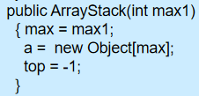


Stack Exceptions
Attempting the execution of an operation of ADT may sometimes cause an error condition, called an exception
Exceptions are said to be “thrown” by an operation that cannot be executed
In the Stack ADT, operations pop and top cannot be performed if the stack is empty
Attempting the execution of pop or top on an empty stack throws an StackEmptyException.

Slide 17
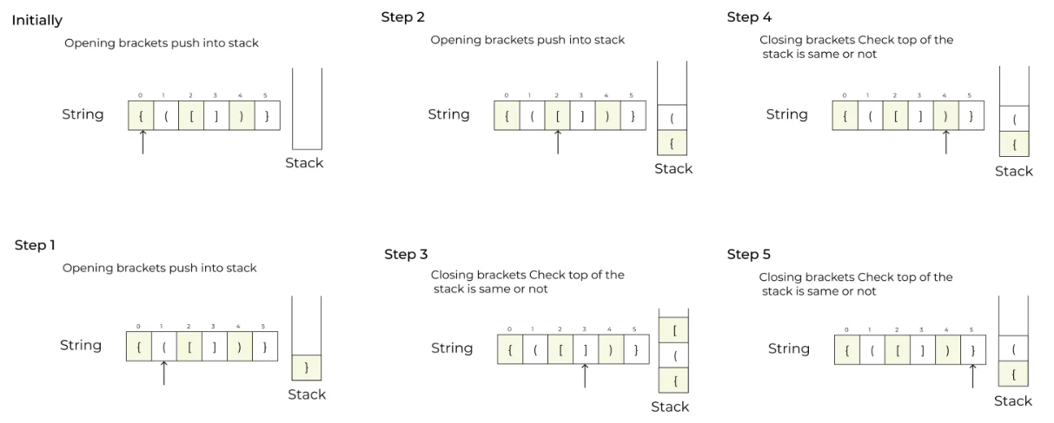

Validate expression using stack - 1

Slide 18
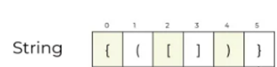


Validate expression using stack - 1

Slide 19
Validate expression using stack - 1
We consider arithmetic expressions that may contain various pairs of grouping symbols, such as
• Parentheses: “(” and “)”
• Braces: “{” and “}”
• Brackets: “[” and “]”
Each opening symbol must match its corresponding closing symbol. For example, a left bracket, “[,” must match a corresponding right bracket, “],” as in the following expression
[(5+x)−(y+z)].
The following examples further illustrate this concept:
• Correct: ( )(( )){([( )])}
• Correct: ((( )(( )){([( )])}))
• Incorrect: )(( )){([( )])}
• Incorrect: ({[ ])}
• Incorrect: (

Slide 20
Validate expression using stack - 2
An Algorithm for Matching Delimiters:
An important task when processing arithmetic expressions is to make sure their delimiting symbols match up correctly.
We can use a stack to perform this task with a single left-to-right scan of the original string.
Each time we encounter an opening symbol: we push that symbol onto the stack
Each time we encounter a closing symbol: we pop a symbol from the stack (assuming it is not empty) and check that these two symbols form a valid pair.
If we reach the end of the expression:
If the stack is empty: the original expression was properly matched.
Otherwise, there must be an opening delimiter on the stack without a matching symbol.
If the length of the original expression is n, the algorithm will make at most n calls to push and n calls to pop.

Slide 21
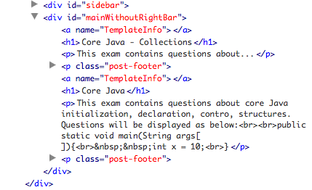
Matching Parentheses and HTML Tags

Slide 22
Matching Parentheses and HTML Tags
HTML is the standard format for hyperlinked documents on the Internet and XML is an extensible markup language used for a variety of structured data sets.
Another application of matching delimiters is in the validation of markup languages such as HTML or XML.
In an HTML document, portions of text are delimited by HTML tags. A simple opening HTML tag has the form “<name>” and the corresponding closing tag has the form “</name>”. For example, the <body> tag has the matching </body> tag at the close of that document.
Ideally, an HTML document should have matching tags, although most browsers tolerate a certain number of mismatching tags. We can use stack to check whether an HTML document is valid or not.

Slide 23
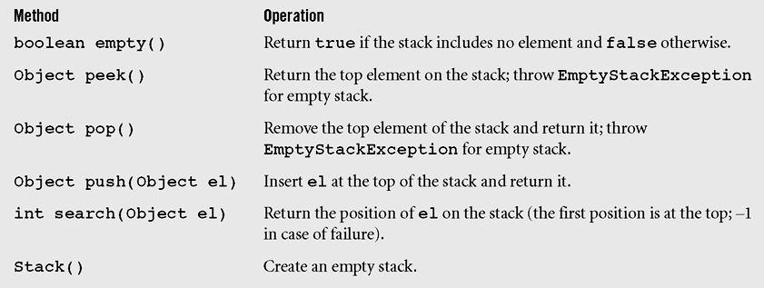
Stack class in Java
A Stack class implemented in the java.util package is an extension of class Vector to which one constructor and five methods are added.
Stack class in Java

Slide 24
Exercise
The term "push" and "pop" is related to the
A. stacks
B. lists
C. array
D. queues

Slide 25
Exercise
The operation for removing and returning the top element of the stack is traditionally called:
A. delete
B. peek
C. pop
D. remove

Slide 26
Exercise
The operation for adding an entry to a stack is traditionally called:
A. push
B. append
C. insert
D. add

Slide 27
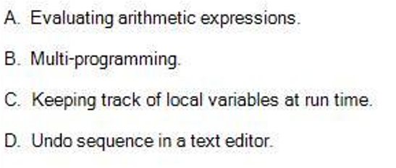
Exercise

Slide 28
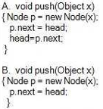
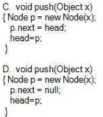
Exercise
Suppose we are implementing a stack using a singly linked list where the head of the list is treated as the top of the stack.
Specify the correct implementation of push() method of the stack. (Choose the most suitable one)

Slide 29
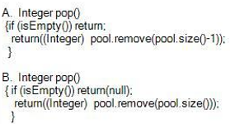
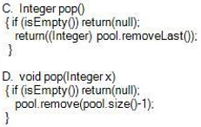
Exercise
Suppose we are implementing a stack using java.util.LinkedList for storing data where the end of the list is treated as the top of the stack.
Specify the correct implementation of pop() method of the stack. (Choose the most suitable one)

Slide 30
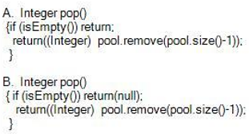
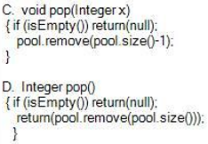
Exercise
Suppose we are implementing a stack using java.util.LinkedList for storing data where the end of the list is treated as the top of the stack.
Specify the correct implementation of pop() method of the stack. (Choose the most suitable one)

Slide 31
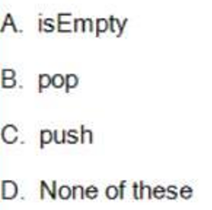
Exercise
Which of the following stack operations could result in stack underflow?

Slide 32
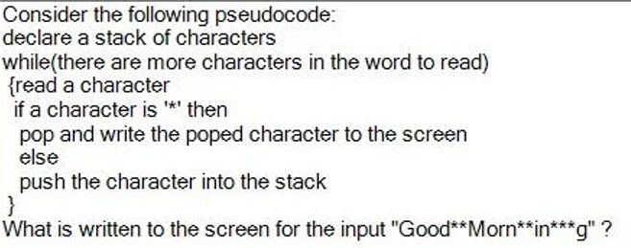
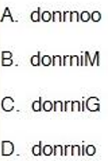
Exercise

Slide 33
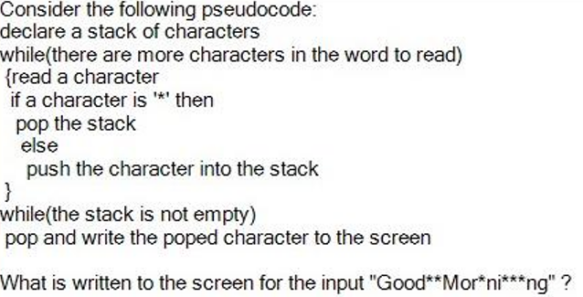
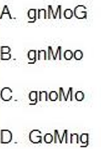
Exercise

Slide 34
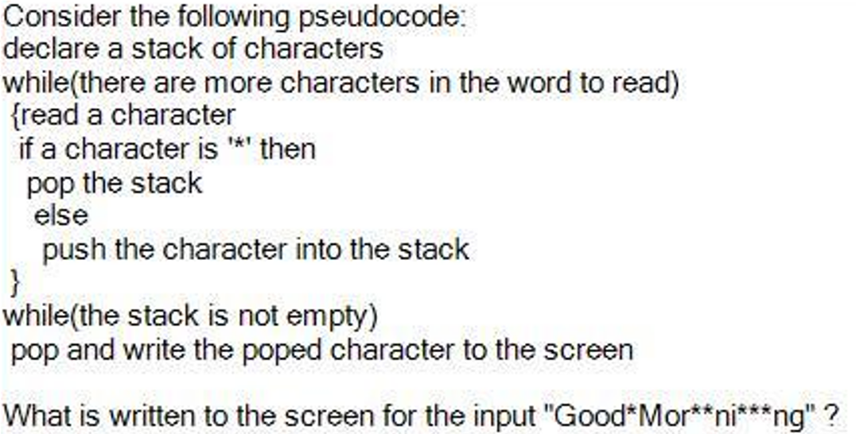
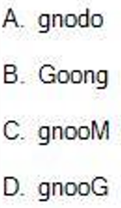
Exercise

Slide 35
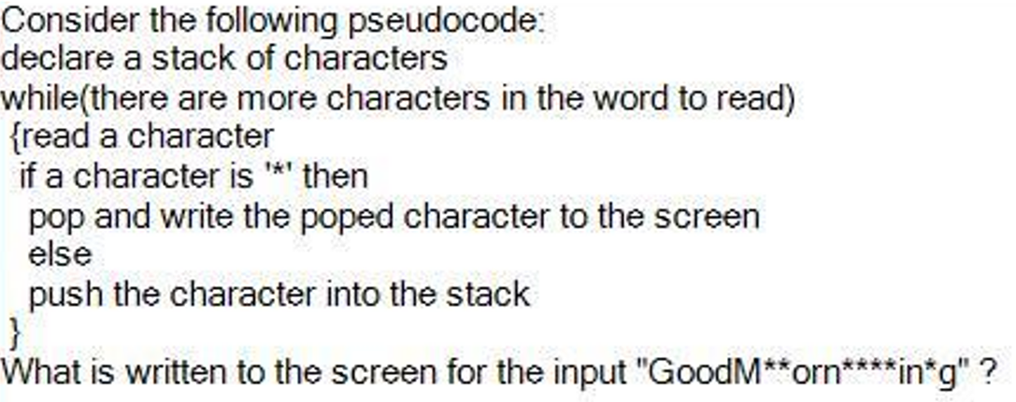
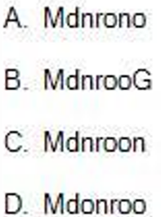
Exercise

Slide 36
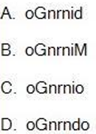
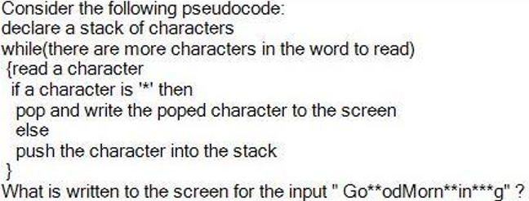
Exercise

Slide 37
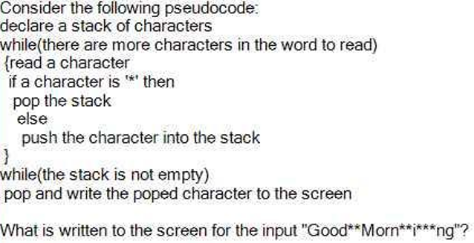

Exercise

Slide 38
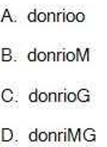
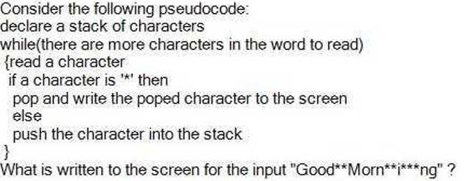
Exercise

Slide 39
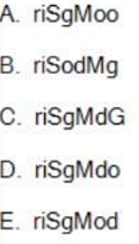
Exercise
Consider the following pseudocode:
declare a stack of characters
while(there are more characters in the word to read)
{read a character
if a character is ‘*’ then
pop the stack
else
push the character into the stack
}
while(the stack is not empty)
pop and write the poped character to the screen
What is written to the screen for the input "Go ** odMorn ** in *** gSir"?

Slide 40
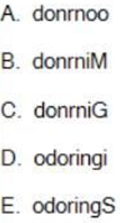
Exercise
Consider the following pseudocode:
declare a stack of characters
while(there are more characters in the word to read)
{read a character
if a character is ‘*’ then
pop and write the poped character to the screen
else
push the character into the stack
}
What is written to the screen for the input "Go*od ** Mor*ni ** ng*Si*r"?

Slide 41
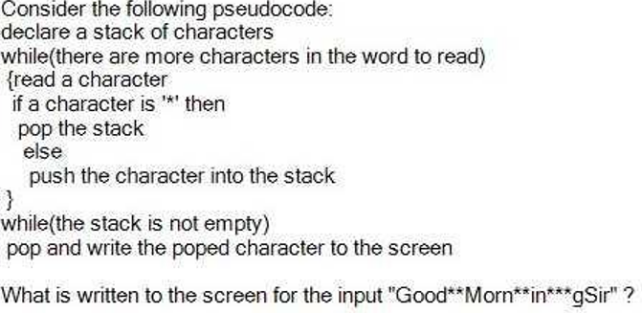
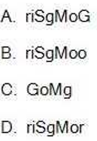
Exercise

Slide 42
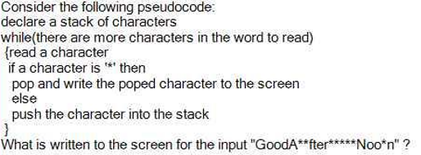
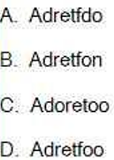
Exercise

Slide 43
Exercise
- Enter into the stack: 1, 0, 2, D, S, C, 9
- Print the stack to the screen
- Pop an element from the stack --> Print the stack to the screen
- Search for the element entered from the keyboard. If the element is in the stack, print its position. Otherwise, if it does not exist, print the message "Not found".
- Push the following elements into the stack: ,E, V, O, L, ,I
- Print the stack to the screen in reverse order

Slide 44
Summary
A stack is a linear data structure that can be accessed at only one of its ends for storing and retrieving data.
A stack is called an LIFO structure: last in/first out.

Slide 45
Reading at home
Text book: Data Structures and Algorithms in Java.
6 Stacks, Queues, and Deques 225
6.1 Stacks - 226

